Slide 1
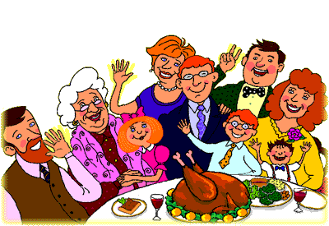
Family Day

Slide 2
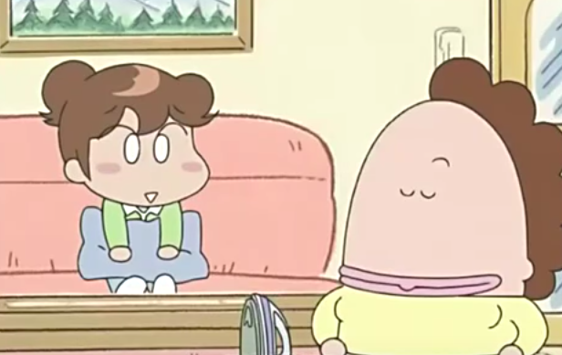
___ my _______.
She’s
mother

Slide 3
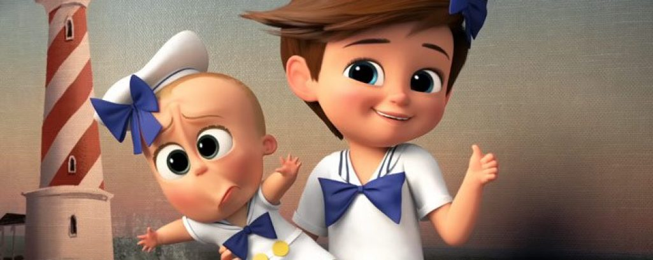
___ my _______.
He’s
brother

Slide 4
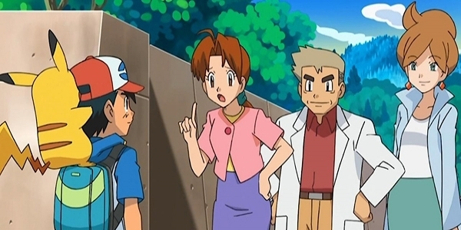
___ my _______.
She’s
mother

Slide 5
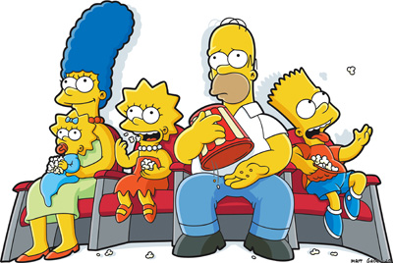
___ my _______.
He’s
father

Slide 6
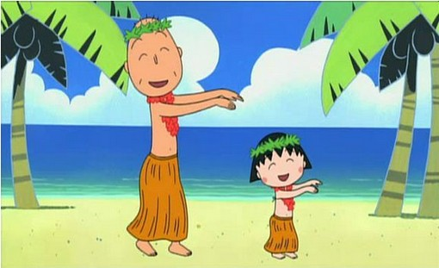
___ my _____.
He’s
grandpa

Slide 7
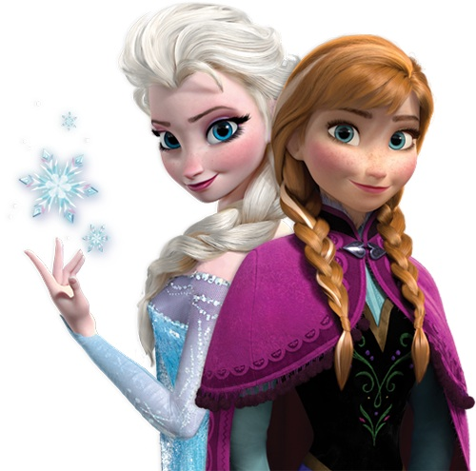
___ my _______.
She’s
sister

Slide 8
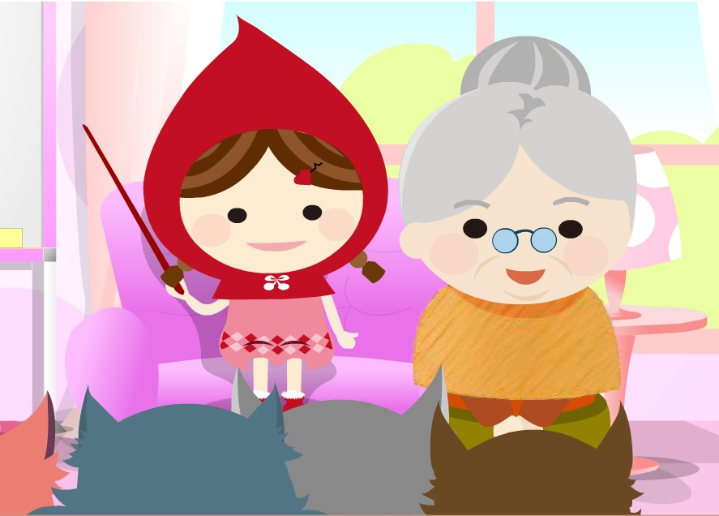
___ my _______.
She’s
grandma

Slide 9
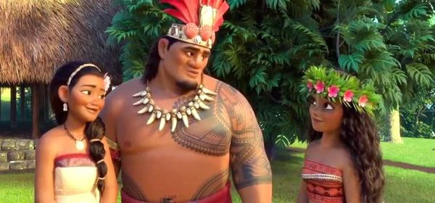
___ my _____.
He’s
father

Slide 10
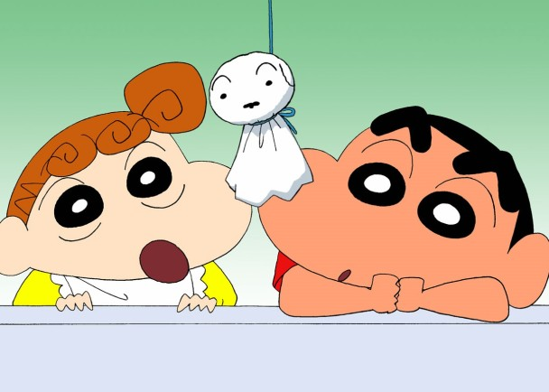
___ my ______.
He’s
brother

Slide 11
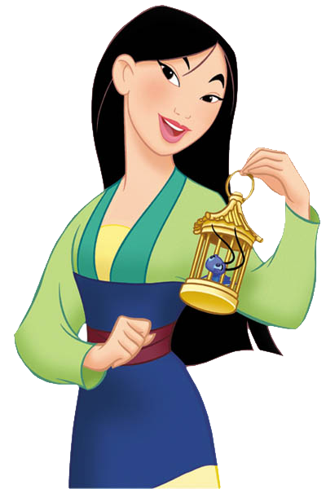
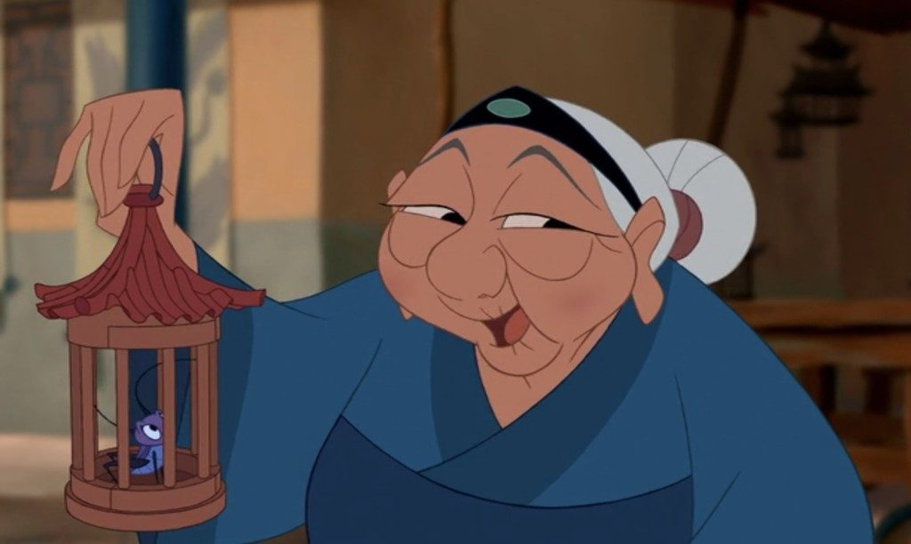
___ my _____.
She’s
grandma

Slide 12
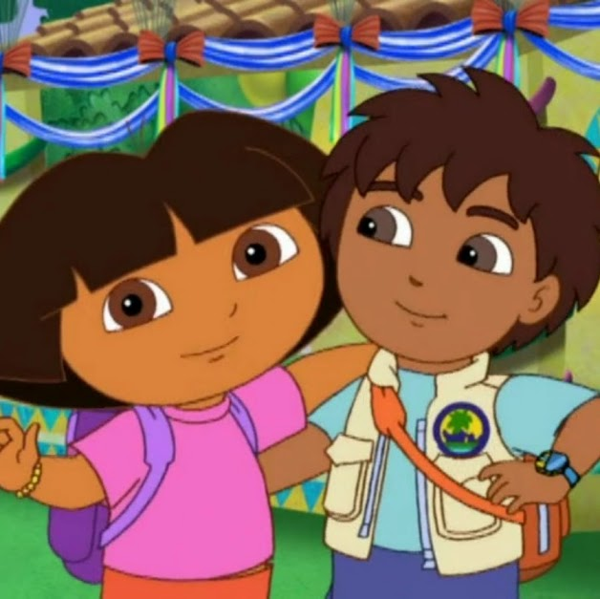
___ my _______.
She’s
sister

Slide 15
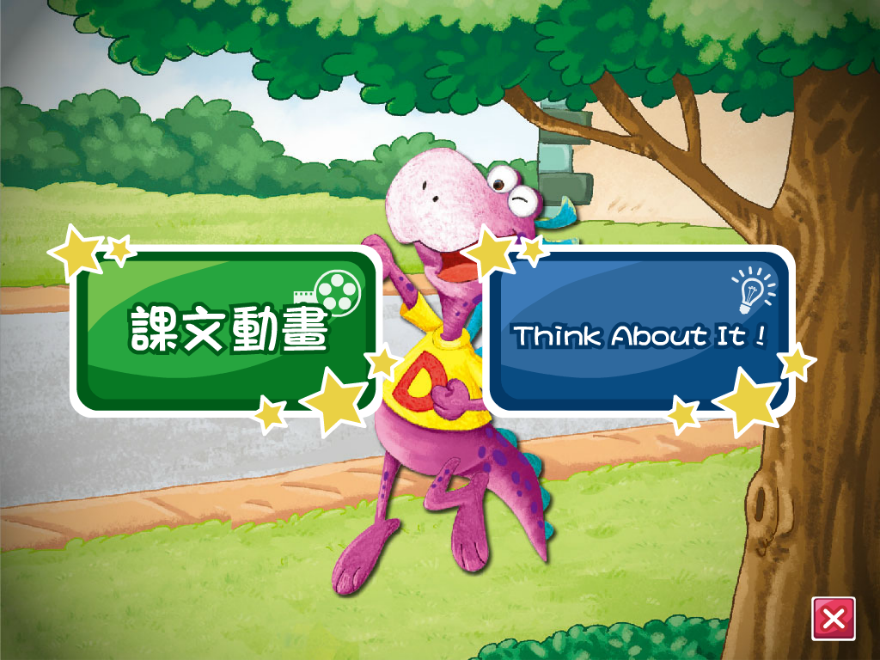

Slide 16
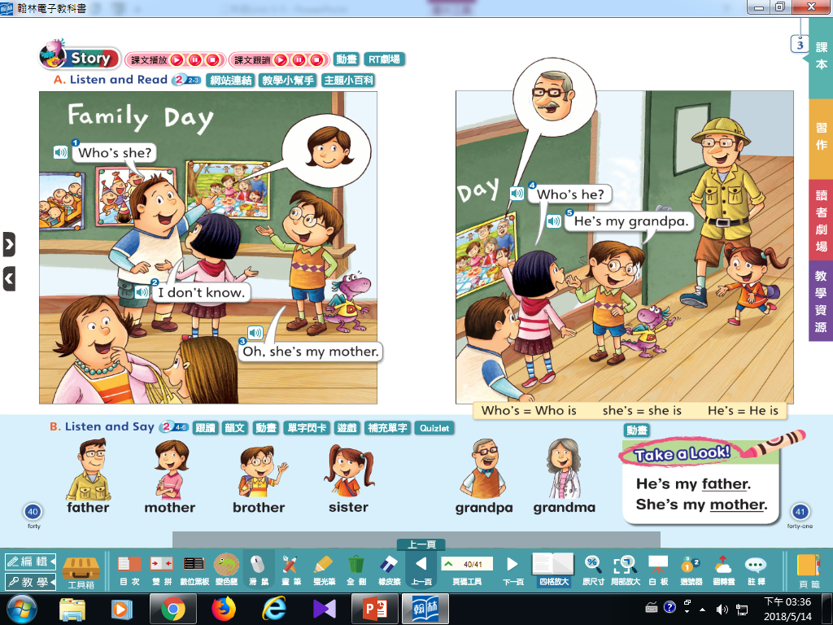
我不知道
He is
she is

Slide 17
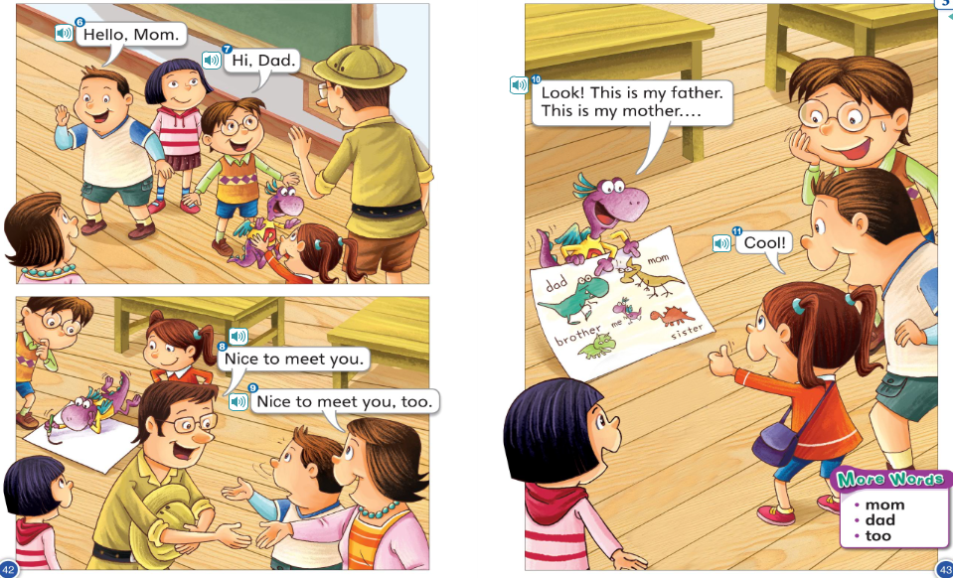
自己的父母要大寫
也

Slide 19
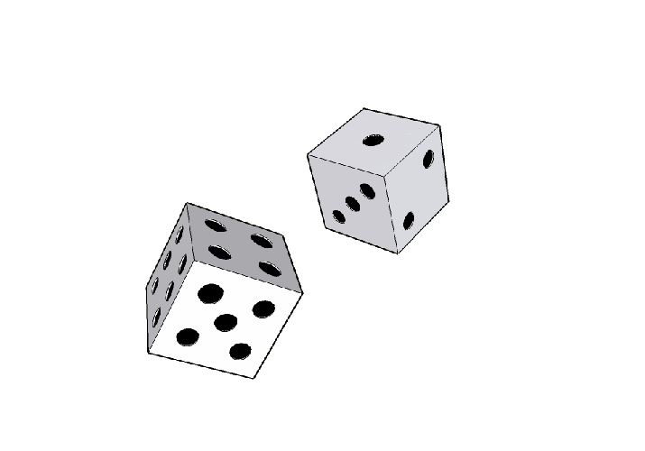
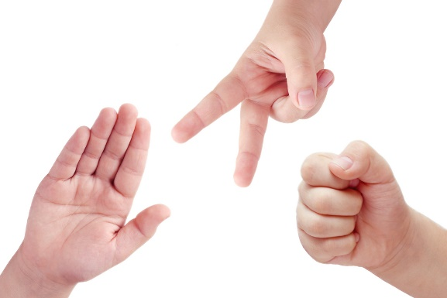
1 → Echo (last words for 3 times)
2 → Group 2/4/6 read
3 → Group 1/3/5 read
4 → Mandy reads (Find mistake)
5 → Free
6 →

